Slide 1


STATISTICS
Session 5: Estimation

Slide 2



Populations and Samples
Population
Estimation is a fundamental part of statistics:
we use what we can observe (the sample)
to learn about what we cannot observe directly (the population).
$$μ,σ,etc.$$
$$\overline{x},s,etc.$$
Sample

Slide 3
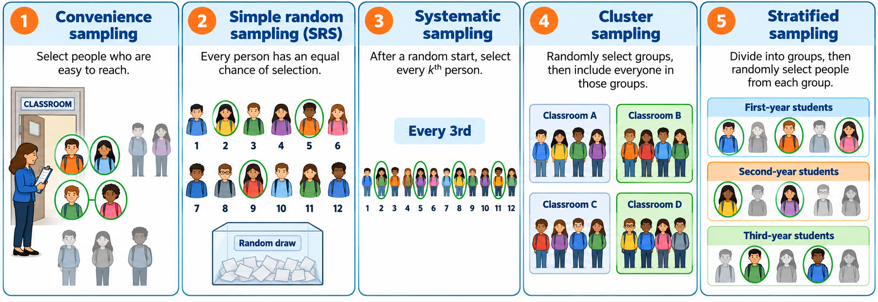
A good sampling method can reduce error in our estimates
Observed value = True value + Systematic Error + Random Error

Slide 4

Populations and Samples
Suppose you work for the Australian Bureau of Statistics. You have been asked to report the typical annual income of Australian households. This sounds simple, but it immediately raises statistical questions:
What counts as a household?
What counts as income?
Are we interested in the mean, the median, or the proportion of households below a particular income level?
If we only survey a sample of households, how close will our answer be to the truth?

Slide 5
Parameters and Statistics
But which statistic should we use?
The mean isn't automatically the right statistic. It depends on the question we're asking and the characteristic of the population that we're trying to estimate.”

Slide 6
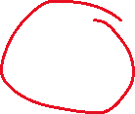
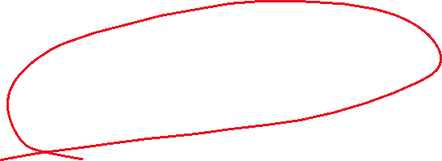

Parameters and Statistics
1
Population
2
parameter
5
If we had chosen a different sample, would we have the same estimate?
3
statistic
4
Sample

Slide 7
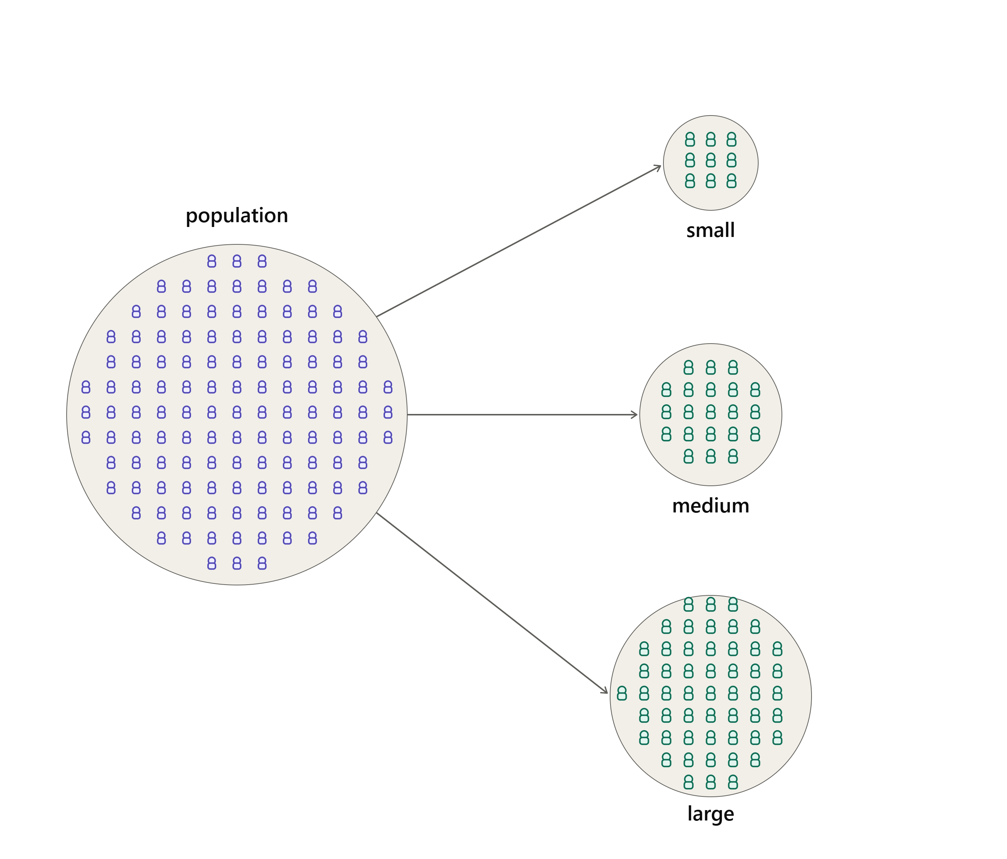
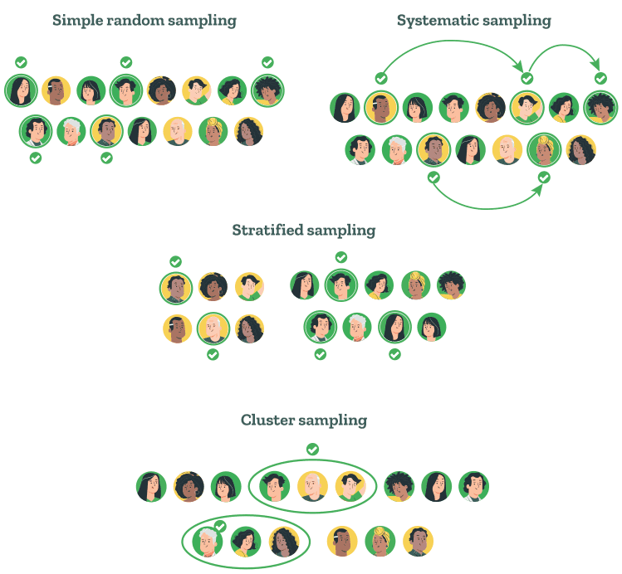
Parameters and Statistics
Observed value = True value + Systematic Error + Random Error

Slide 8


Random variables
Random variables
Population
parameter
(Potential Data)
$$X_{1},X_{2},X_{3}…X_{n}$$
statistic
Sample
(Observed Data)
$$x_{1},x_{2},x_{3}…x_{n}$$

Slide 9
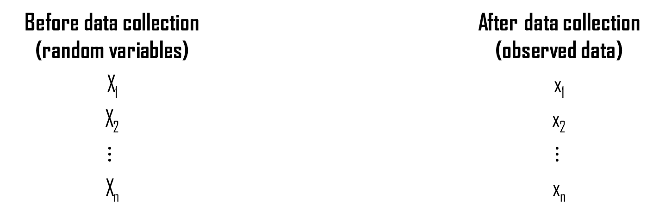
Random variables
Before data collection (random variables) |  | After data collection (observed data)
X₁ |  | x₁
X₂ |  | x₂
$$⋮$$ |  | $$⋮$$
X_{n} |  | x_{n}

Slide 10

Probability Distributions
PROBABILITY DISTRIBUTION
$$X f(x)$$
PROBABILITY DENSITY FUNCTION
PROBABILITY MASS FUNCTION
RANDOM VARIABLE

Slide 11
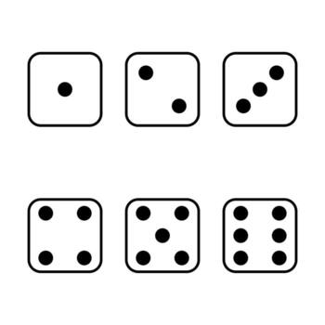
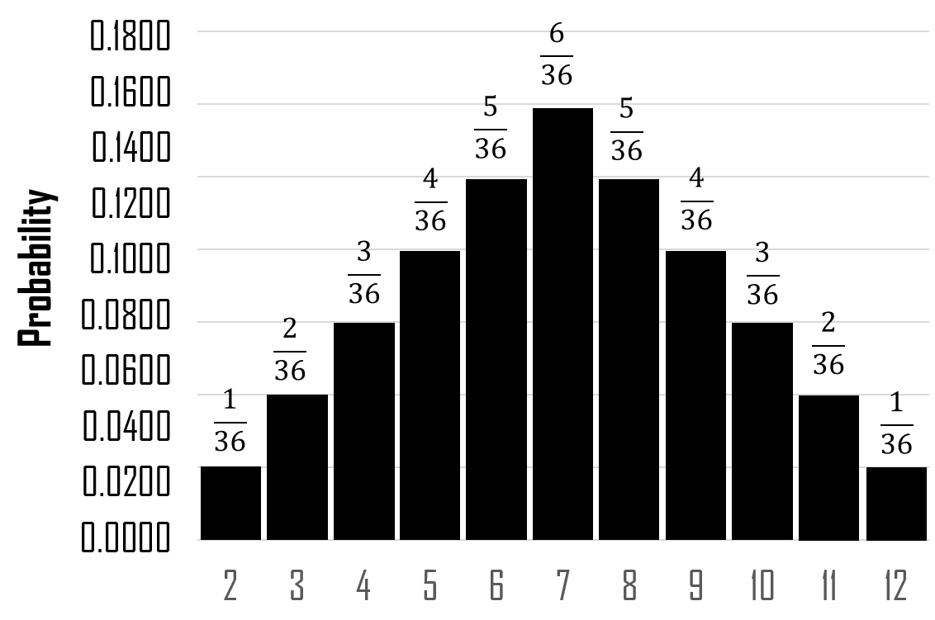
Probability Distributions - Discrete
 | 2 | 3 | 4 | 5 | 6 | 7
 | 3 | 4 | 5 | 6 | 7 | 8
 | 4 | 5 | 6 | 7 | 8 | 9
 | 5 | 6 | 7 | 8 | 9 | 10
 | 6 | 7 | 8 | 9 | 10 | 11
 | 7 | 8 | 9 | 10 | 11 | 12

Slide 12

Probability Distributions - Continuous
$73,251
$87,000
$90,500
$91,000
$93,256.50
$93,256.6365
$93,256.637
$93,257
$95,000
$100,000

Slide 13
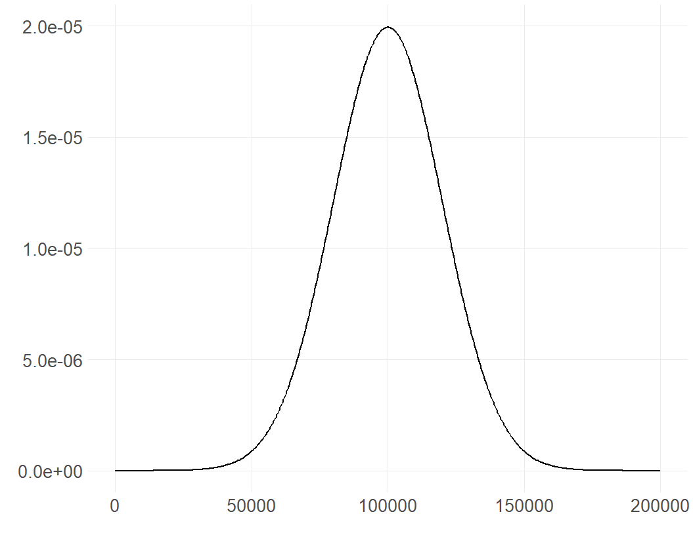
Probability Distributions - Continuous

Slide 14
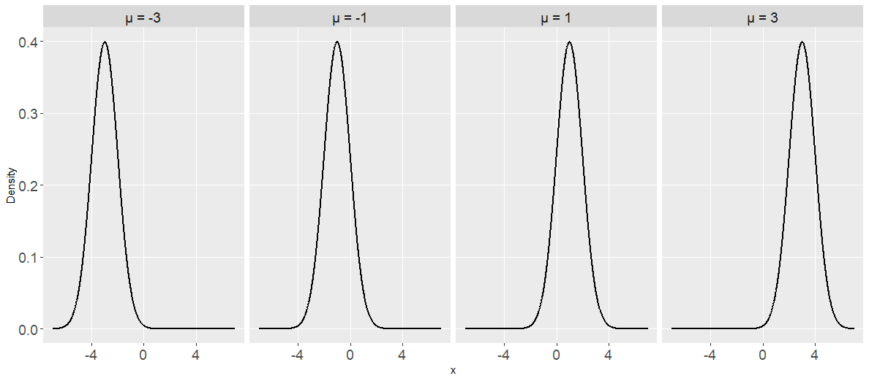
Normal Distribution – μ

Slide 15
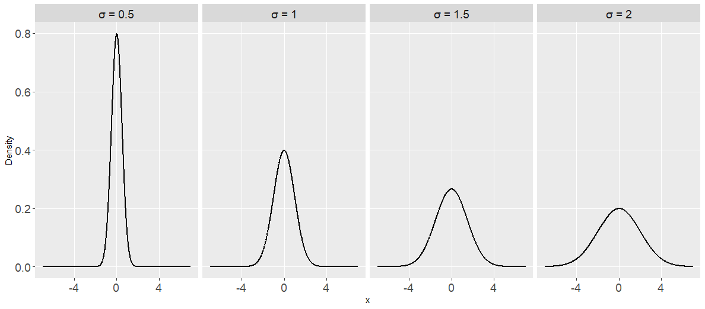
Normal Distribution – σ

Slide 16
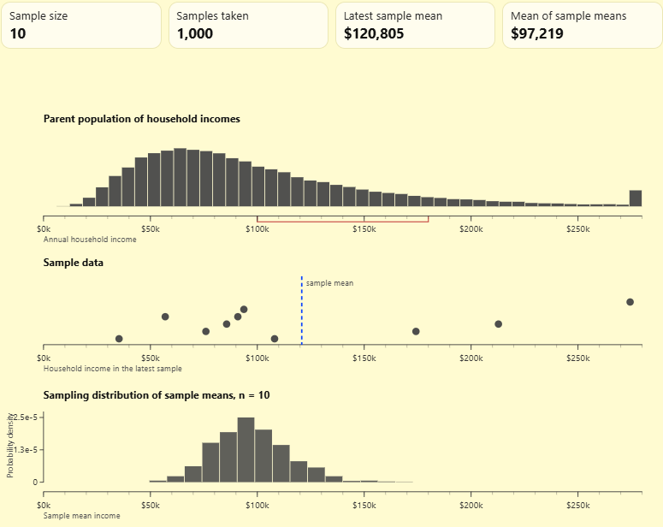
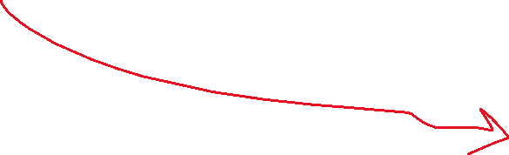
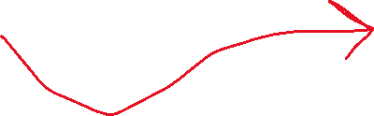
Sampling Distribution
Our one sample gives us one observed value of our estimate:
The sampling distribution tells us how much that estimate would vary if we could repeat the sampling process

Slide 17
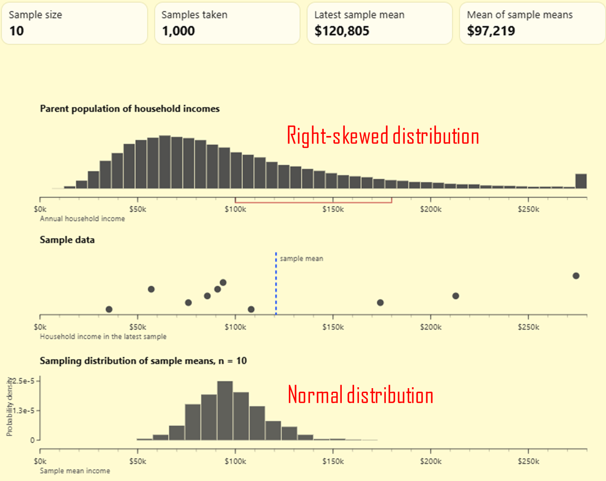
Central Limit Theorem
The population of interest does not necessarily have to be normal for the sampling distribution of the mean to be approximately normal.

Slide 18
Central Limit Theorem
The population of interest does not necessarily have to be normal for the sampling distribution of the mean to be approximately normal.

Slide 19

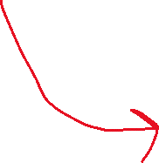

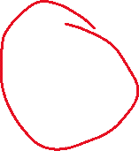
Sampling Distribution
Random variables
Population
parameter
(Potential Data)
$$\overline{x}$$
statistic
Sample
(Observed Data)

Slide 20


Standard Error
$$Standard Error$$
Shows how much the sample statistic itself varies across different potential samples
$$SE\left(\overline{X}\right)=σ/{\sqrt{n}}$$
Where 𝜎 is the population std. deviation and n is the sample size

Slide 21



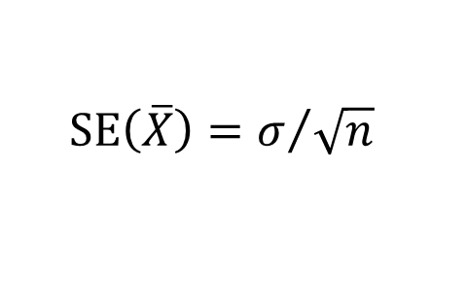


Standard Error – when σ is known
$$N(μ=100,σ=7.5)$$
Random variables
Population
parameter
(Potential Data)
$$SE\left(\overline{X}\right)=σ/{\sqrt{n}}$$
$$\overline{x}=93$$
$$SE\left(\overline{X}\right)={7.5}/{\sqrt{10}}$$
statistic
$$SE\left(\overline{X}\right)=2.37$$
Sample
$$n=10$$

Slide 22



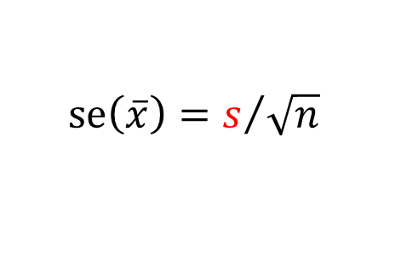

Standard Error – when σ is unknown
$$N(μ= ?,σ= ?)$$
Random variables
Population
parameter
(Potential Data)
$$se\left(\overline{x}\right)=s/{\sqrt{n}}$$
$$\overline{x}=93, s=15.2$$
$$SE\left(\overline{X}\right)={15.2 }/{\sqrt{10}}$$
statistic
$$SE\left(\overline{X}\right)=4.81$$
Sample
$$n=10$$

Slide 23







Reporting estimates with SE
$$estimate±std.error$$
UNIVERSITY A
UNIVERSITY B
$$±0.15$$
$$±0.29$$
$$\hat{p}=.70$$
$$\hat{p}=.70$$
$$\hat{p}$$
$$\hat{p}$$
0
0.25
0.50
0.75
1
0
0.25
0.50
0.75
1
Employment Rate
Employment Rate

Slide 24
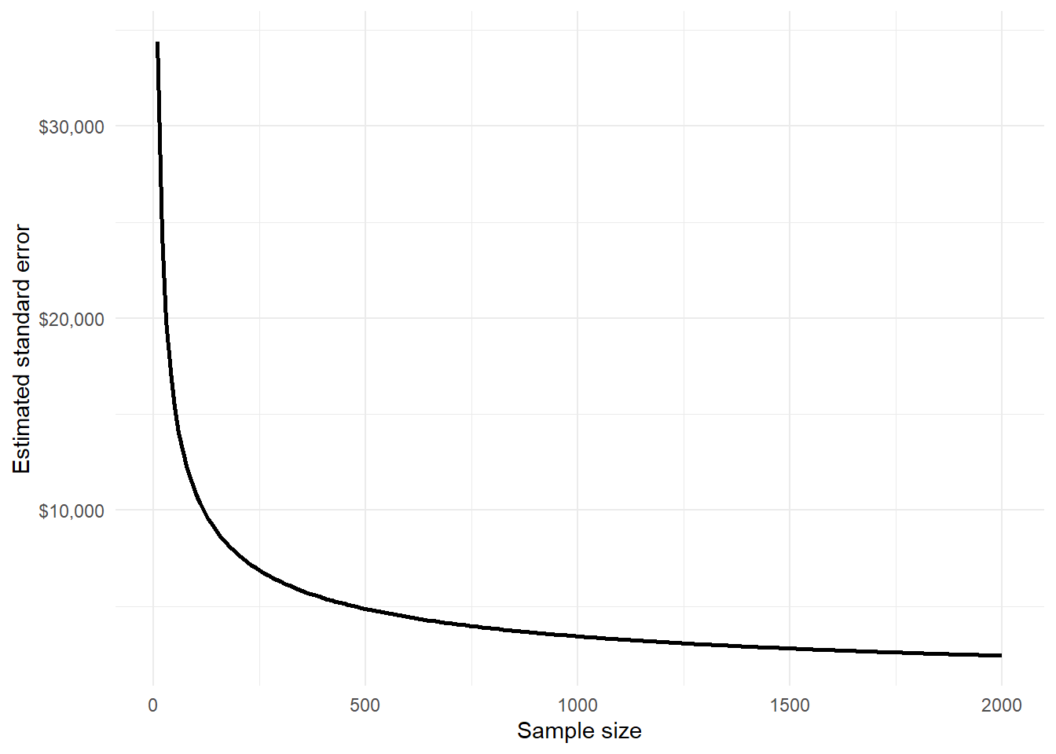
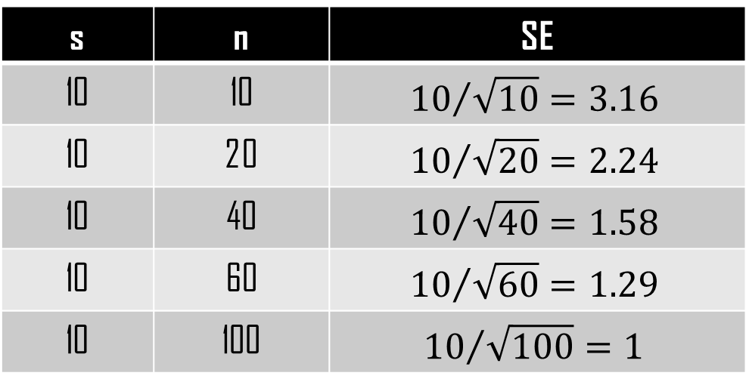
Standard Error and Sample Size
Increasing the sample size reduces the standard error, but with diminishing returns.
To halve the standard error, we generally need about four times the sample size.
s | n | SE
10 | 10 | $${10}/{\sqrt{10}=3.16}$$
10 | 20 | $${10}/{\sqrt{20}=2.24}$$
10 | 40 | $${10}/{\sqrt{40}=1.58}$$
10 | 60 | $${10}/{\sqrt{60}=1.29}$$
10 | 100 | $${10}/{\sqrt{100}=1}$$

Slide 25
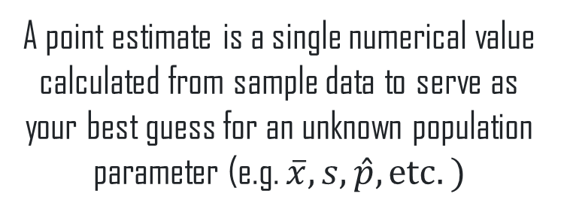

Point and Interval Estimate
POINT ESTIMATE
INTERVAL ESTIMATE
A point estimate is a single numerical value calculated from sample data to serve as your best guess for an unknown population parameter (e.g. $\overline{x},s,\hat{p},etc.)$
An interval estimate is a range of values calculated from sample data that is likely to contain an unknown population parameter, e.g. confidence intervals, margin of error
$$\hat{p}$$
0
0.25
0.50
0.75
1
0
0.25
0.50
0.75
1

Slide 26
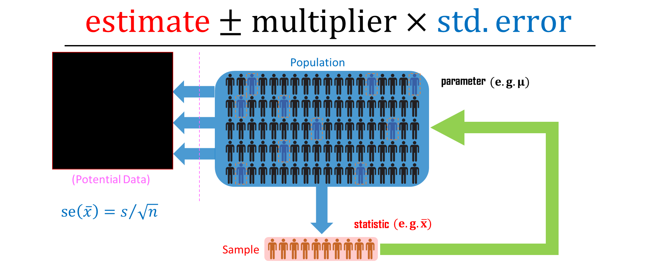
Confidence Interval
A confidence interval is a range of values which is likely to contain (in repeated sampling) the true value of an unknown statistical parameter, such as a population mean

Slide 27
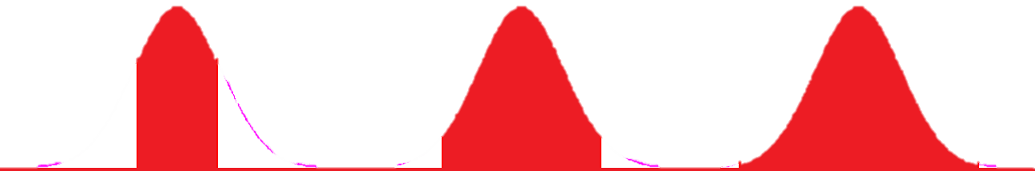
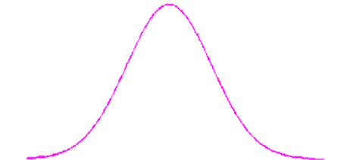
Confidence Interval
0.683
0.954
0.997
-1σ
μ
+1σ
-2σ
μ
+2σ
-3σ
μ
+3σ

Slide 28
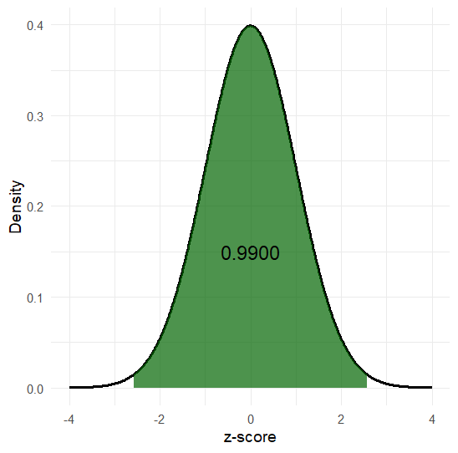
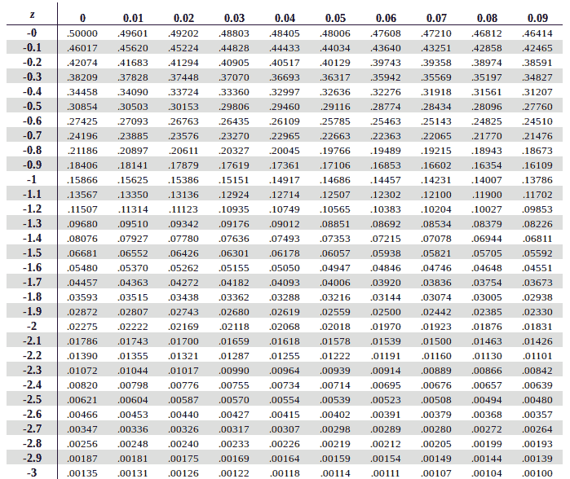
Confidence Interval - multiplier
0.005
0.005
$$99\%CI=estimate±2.58×std.error$$

Slide 29
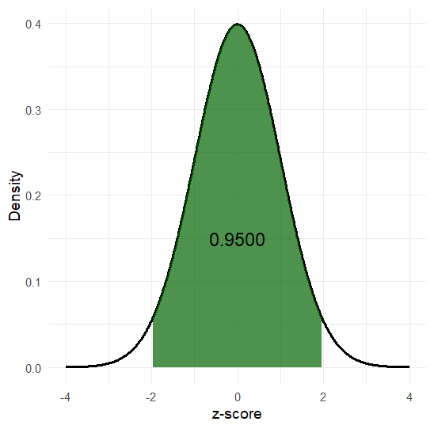
Confidence Interval - multiplier
0.025
0.005
0.025
0.005
$$95\%CI=estimate±1.96×std.error$$

Slide 30
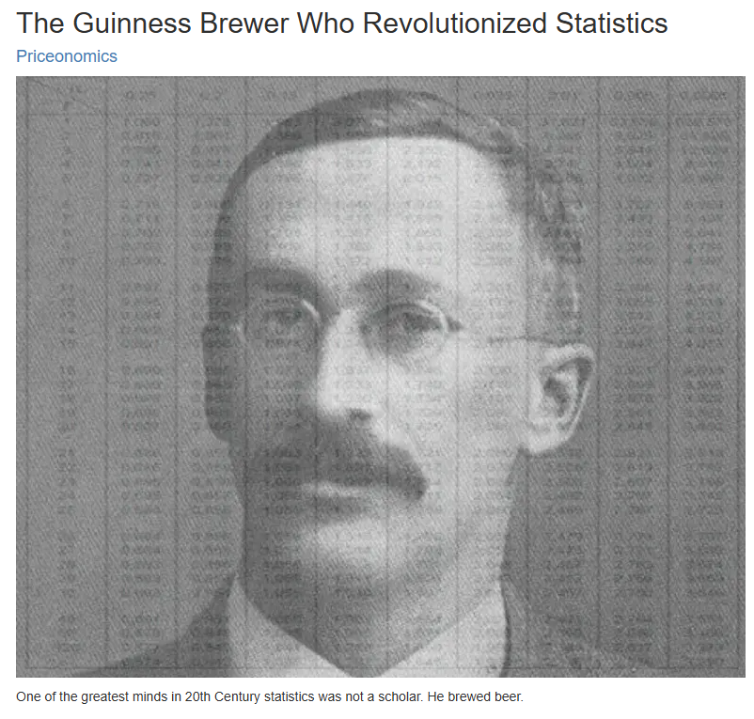
William Gosset – The t (student) distribution
Gosset was interested in small samples because Guinness often had to make decisions using relatively small amounts of data.
In 1908, he published an article: “The Probable Error of a Mean”
Because Guinness did not allow employees to publish under their own names, he published the paper under the pseudonym “Student.” That's why we commonly call it Student's t-distribution.
The t-distribution provides a way to account for the extra uncertainty from estimating the population standard deviation using the sample standard deviation.

Slide 31
Degrees of Freedom (df)
The df depend on the statistical procedure and how much information is available to estimate the parameters of the model. In general, degrees of freedom represent the amount of independent information available for estimating variability.
Statistical procedure | Degrees of freedom
One-sample t-test | n - 1
Paired-samples t-test | n - 1, where n is the number of pairs
Two-sample t-test (pooled) | n₁ + n₂ - 2
Welch's two-sample t-test | Approximate df based on n₁, n₂, s₁, and s₂
One-way ANOVA | Between groups: k – 1; Within groups: N – k
Chi-square test of independence | (r-1) x (c-1)
Chi-square goodness-of-fit | k - 1
Simple linear regression | n - 2 for testing the slope
Multiple linear regression | n - p - 1, where p = number of predictors

Slide 32
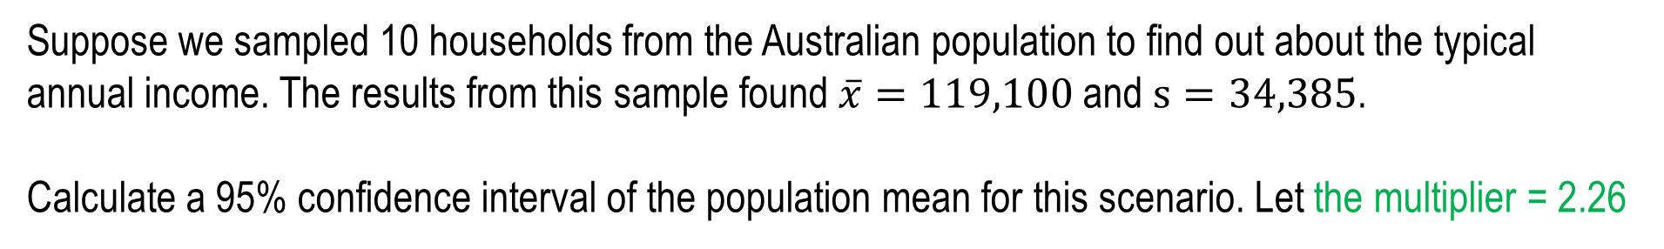
Practice Questions – Confidence Intervals
Suppose we sampled 10 households from the Australian population to find out about the typical annual income. The results from this sample found $\overline{x}=119,100$ and $s=34,385$.
Calculate a 95% confidence interval of the population mean for this scenario. Let the multiplier = 2.26

Slide 33
Practice Questions – Confidence Intervals
In the previous question, we calculated a 95% confidence interval for the population mean as $94,525.91 to $143,674.10. Consider the following statement:
There is a 95% probability that the true population mean is between $94,525.91 and $143,674.10.
Is this statement true or false?

